Slide 1
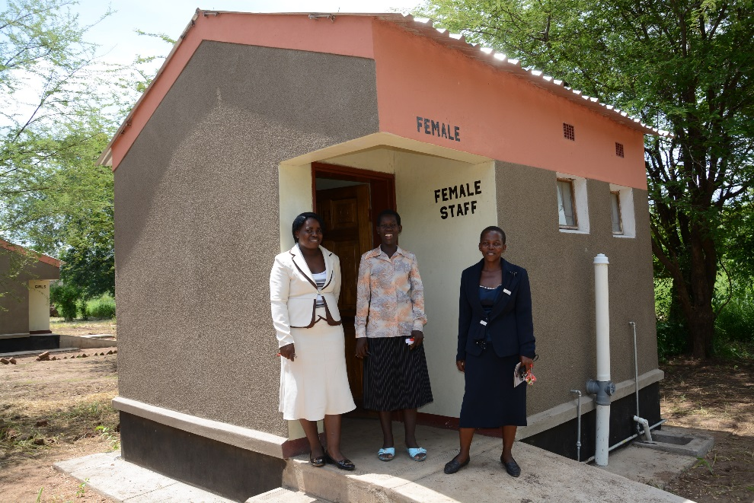
Mainstreaming Menstrual Hygiene Management
in the Ministry of Education in Zambia
Sarah Fry
WASHplus/FHI360

Slide 2
SPLASH* Zambia
4 year (2011-2015) School WASH program
Funded by USAID, managed by FHI360 and CARE
600+ schools in Eastern Province, 250,000 pupils reached
Water and sanitation facilities construction
Hygiene education in and out of classroom
School to community actions, O&M
Partnerships with UNICEF, private sector and NGOs
*Schools Promoting Learning Achievement through Sanitation and Hygiene
Notes:
The Zambia SPLASH project’s objective was
“To sustainably improve access to safe water, adequate sanitation, hygiene information & health practices to improve learning environments & educational performance in Zambian primary schools.”
MHM was included in its design and was originally developed as a part of the infrastructure component – offering washrooms with the girls’ latrines for older girls to clean up ay school during their periods. MHM soon grew into a comprehensive program including hardware, software and strengthening the enabling environment.

Slide 3
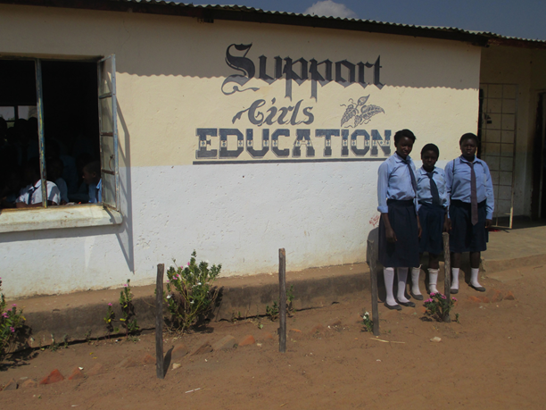
Why MHM creates opportunities to learn for girls
MHM keeps girls in school
Increases the number of educated girls and women
Increases a girl’s confidence, sense of value and self worth
Lack of MHM is a big reason girls stay home from school. They can lose up to 5 days of school per month, then lose track of school work, and eventually drop out
Access to facilities retains female teachers
An educated woman contributes significantly to her family’s health and to the development of her country
Notes:
Hard data may still be scarce for some of these claims, but the SPLASH experience strongly supports them. See the Qualitative Study on slide 6 for details. The link between MHM and keeping girls in school was a main draw for parents to agree to having an MHM program in the schools. With the push of the GRZ to get and keep all children in school, parents were committed to seeing their daughters benefit from at least primary education and once the link between MHM and this became clear, they were on board.

Slide 4
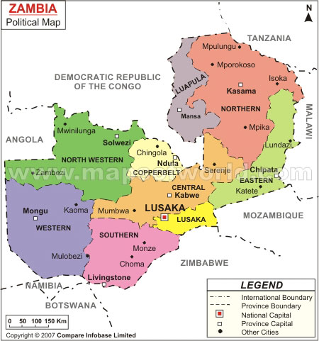
496 schools in 4 districts supported by SPLASH
3 districts supported by UNICEF
Notes:
Zambia has a gender equity problem related to girls staying in school – early marriage, ratio toilets to girls can be as high as 200:1, pregnancy all lead to high girls dropout rates. GRZ is committed to girls education

Slide 5
Focus Areas for Mainstreaming MHM into the MoE System
Qualitative research
Awareness raising and advocacy
Improved facilities and access to products
Teacher/PTA training
Institutional support
Useful documents and job aids on MHM

Slide 6
SPLASH MHM Program Activities
Engage local stakeholders (local councilors, traditional leaders, civic leaders) in a discussion forum on MHM issues
Create girl-friendly “corners”, special spaces or clubs with MHM information and supplies
Make sanitary pads out of locally available materials
Design appropriate and sustainable ways to support MHM in schools (e.g curriculum integration and standards monitoring)
Carry out awareness education with parents and the community at large
Budget for and provide sanitary pads as part of normal school consumables
Create linkages with service providers for support (health practitioners, local businesses and PPPs)
Engage local radio stations to broadcast appealing MHM messages
Train guidance and counseling teachers in MHM

Slide 7
Qualitative Research
Objectives:
To determine the prevailing knowledge, attitudes, perceptions, norms, barriers, and practices related to MHM primarily among adolescent schoolgirls and other target groups in selected rural and urban basic schools in Eastern Province; and
To identify facilitators to improve MHM from the perspectives of primarily adolescent schoolgirls and other target groups.
See Report here

Slide 8
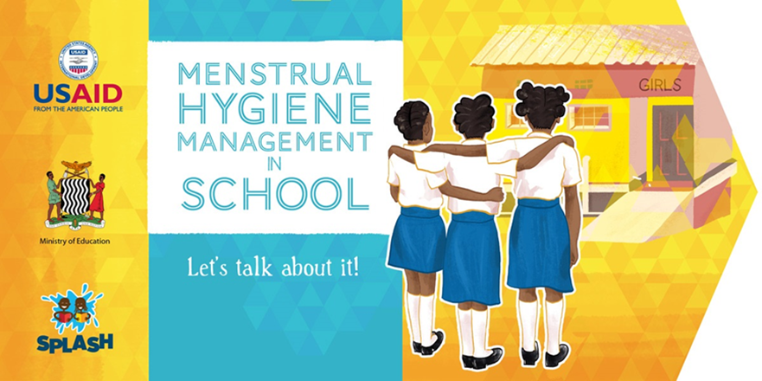
Awareness raising and advocacy
Visual brand and slogan for MHM – Let’s Talk About It!
MHM Mini Exhibitions for school communities
Celebration of MH Day in Zambia with high ranking officials
Inclusion of community and traditional leaders in MHM programs through PTA
Notes:
By turning MHM into a fun and celebratory focus area and activity, PTAs and community members were drawn in and soon became comfortable with openly discussing menstruation and MHM in schools.

Slide 9
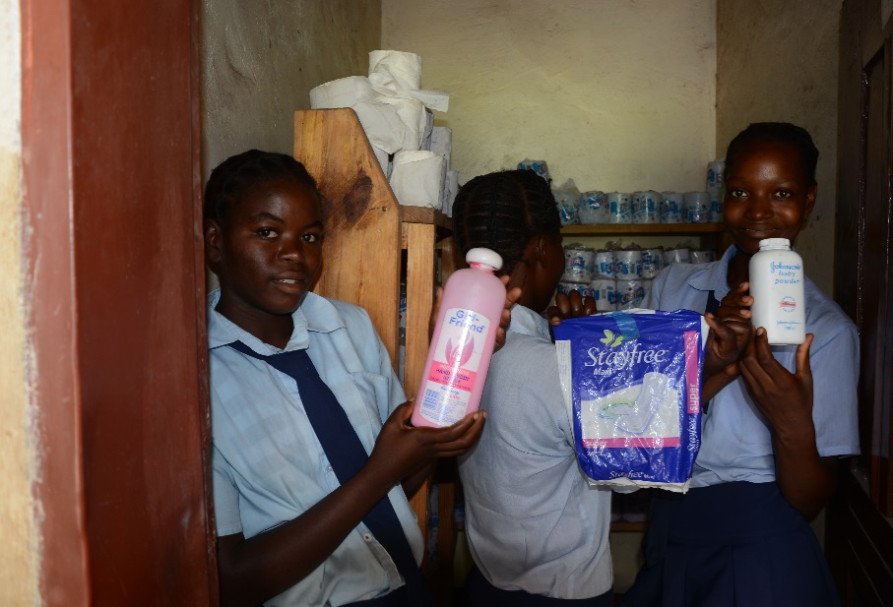
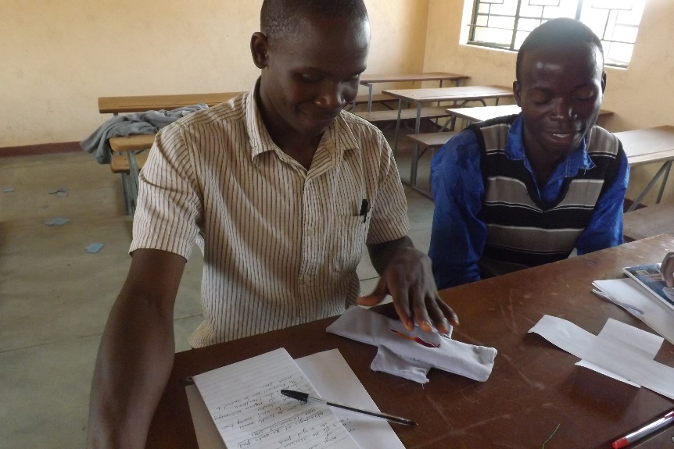
Notes:
Boys and male teachers need to be included in all MHM activities. They can become champions. Boys really like to make pads!

Slide 10
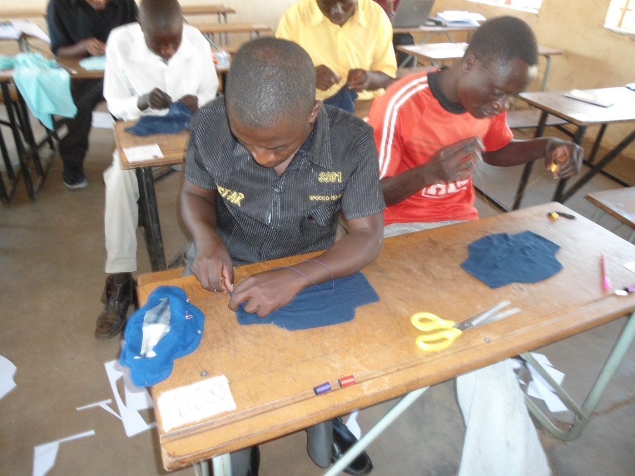
“As a boy, I have a role to play in MHM. These girls are like our sisters so I’ve learnt that I need to treat them with respect. Was also excited to learn how to make a reusable pad.”
-Elias

Slide 11
In and out of classroom activities
MHM included in national curriculum
MHM modules as part of teach in-service training program
Guidance and counseling teachers trained in MHM
WASH clubs have special MHM activities for boys and girls
Integration in MoE Institutional Systems
MHM in provincial and district strategic plans
MHM indicators in school monitoring tool
MHM module introduced in provincial teacher training college

Slide 12
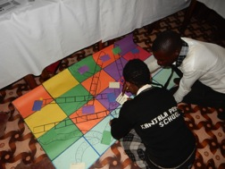
Useful documents and job aids on MHM
Mini Toolkit for Teachers
Pad pattern booklet
Teacher training module for in-service and as part of WASH Friendly Schools training
School Monitoring Tool with MHM section
Games and other classroom and WASH Club teaching resources
MHM ABC classroom poster
Access materials here www.washplus.org/resources

Slide 13
ABC’s of Menstrual Hygiene Management
A
B
C
D
E
F G
H
I
J
K
L
M
Adolescence is the time between childhood and adulthood. During this time, menstruation begins and girls get their periods.
Body changes in girls occur during puberty and menstruation. These changes are normal and girls should not be scared.
Cultural factors and economic constraints can lead to poor menstrual hygiene management among girls.
Doable activities, like pad making parties, can strengthen Menstrual Hygiene Management (MHM) programs in schools.
Exercising and maintaining a healthy diet can reduce the effects of pre-menstrual syndrome (PMS).
Flannel material is recommended for making local re-usable pads because it has maximum absorbency.
Girls can remain in school if MHM activities are effectively, methodically and practically handled and executed.
Hygiene is important when you are menstruating. You should practice good personal hygiene by washing your body at least once a day.
It’s important to use the correct disposal facilities for used menstrual materials, such as sanitary bins, pit latrines or incinerators.
Join WASH clubs in school and see how you can contribute to the development and sustainability of the club in promoting MHM activities.
Keep track of when you get your period so that you can predict when your next one will be.
Locally produced re-usable pads can be made from a variety of materials and can enable girls to keep attending classes during their menses.
Management in schools should support and promote health, hygiene and menstrual discussions.
Notes:
This is an example of what teachers created during MHM training workshops. Locally made teaching materials are highly effective.

Slide 14
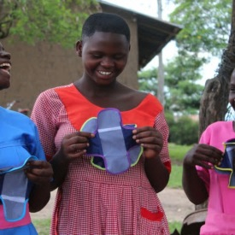
How to Make a Reusable Pad!

Slide 15
Lessons learned
Taboos can break down very fast if there is something positive offered
MHM can and should be integrated into existing systems through advocacy, capacity building, materials, activities and events
MHM can and should be included in school performance indicators and assessment tools
Boys and men must be included in MHM. Boys love to sew pads!

Slide 16
Thank you!

